Slide 1
GRAMENER CASE STUDY
Group Name: Abraca-Data
VIKUL AGGARWAL
VENKITACHALAM RAMASWAMY
ANKIT SAHU

Slide 2
Background – Lending Club Case Study
Lending Club is one of the largest peer-to-peer marketplace which aims to connect borrowers with lenders. The borrowers apply through an online platform where they are assigned a score internally. Based on the score the lenders decide 1.) whether to lend and 2.) the terms of loan like interest rate, tenure, monthly instalment, etc.
Popular products: Debt Consolidation loans, Credit card loans, House loans, Car Loans, etc.
Business Objective:
To identify variables which are strong indicators of default and potentially use the insights in approval / rejection decision making.

Slide 3
DATA UNDERSTANDING
Types of variables:
Variables related to customer's demographics and application
Variables related to the loan characteristics
Variables related to the customer's behavioral characteristic (after they were granted a loan).
Customer Demographics & Application Variables | Loan Characteristics | Behavioral Characteristics
Employee Title | Loan amount | Earliest Credit line
Employee Length | Interest Rate | Recoveries
Annual Income | Tenure of loan | Last Payment Date
Home Ownership | Monthly Installment | Revolving Balance
Purpose | Funded amount | Last Payment amount

Slide 4
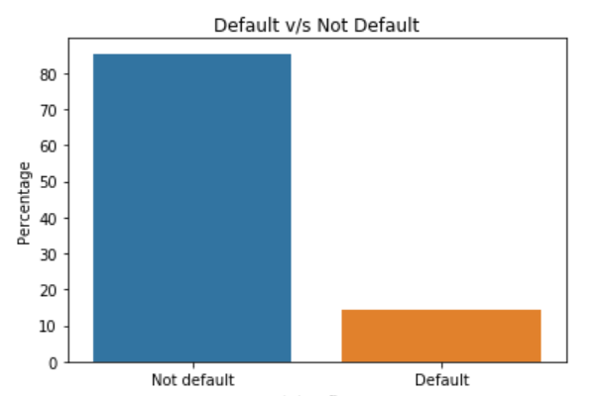
Overall Default Rate
The Overall default rate comes to be ~14.6%

Slide 5
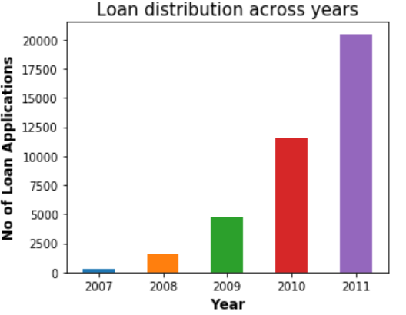
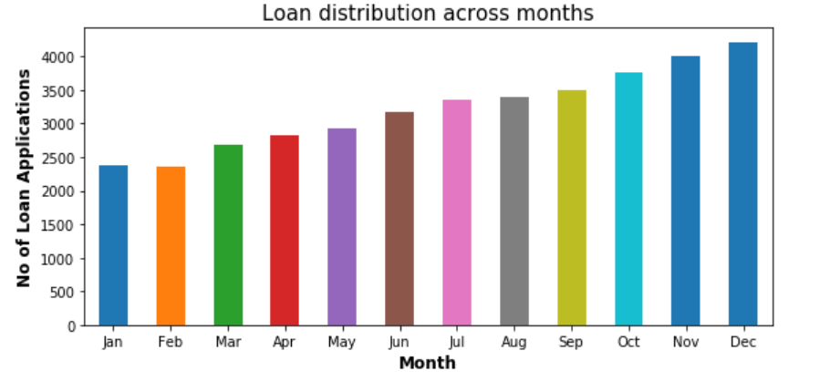
Loan Distribution across Years and Months
We can see a phenomenal rise in the loan distribution from 2007 to 2011.
The number of loan applications are more in the second part of the year.

Slide 6
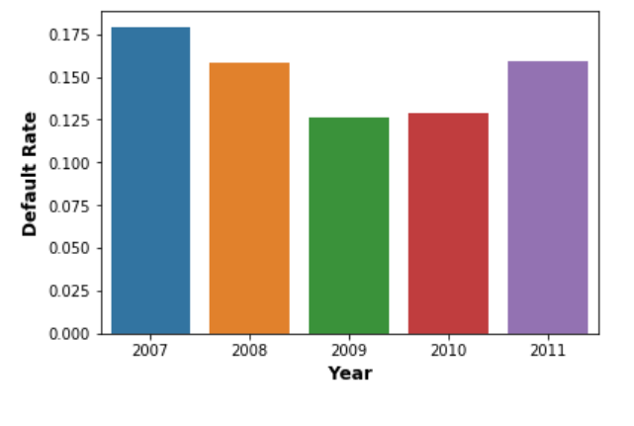
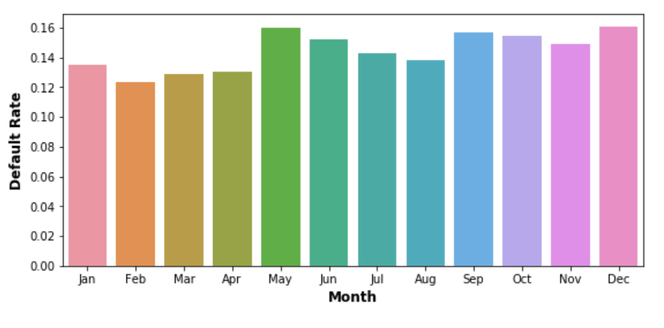
Default Rates across Years and Months
There is a substantial increase in default rates in the year 2011.
The default rates across the months are more or less the same.

Slide 7
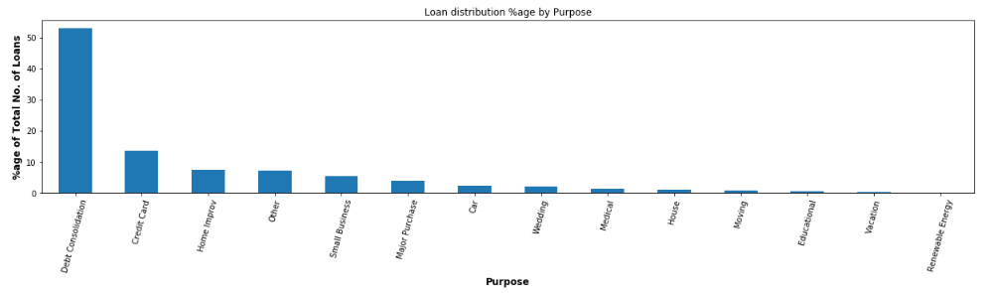
Loan Distribution by Purpose
The top 5 contributors to revenue are Debt Consolidation, Credit Card, Home Improvement,
Small Business and Major Purchase (Combined ~84%).*
* Not considering Other

Slide 8
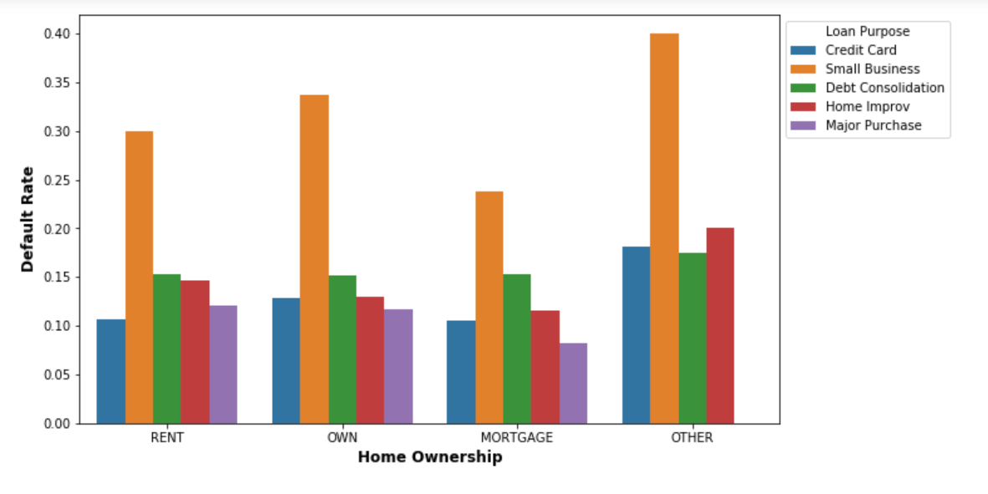
Analysis for Customer Demographic variables: Home Ownership
Small Business loans default the most, followed by Debt Consolidation in most of the home ownership segments

Slide 9
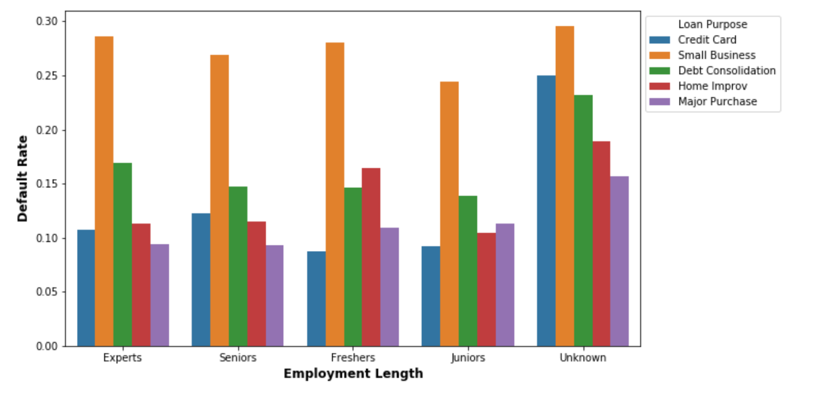
Analysis for Customer Demographic variables : Employment Length
We can see here that Small Business loans have the most default rate followed by Debt Consolidation except freshers, where Home Improvement loans have the second most default rate

Slide 10
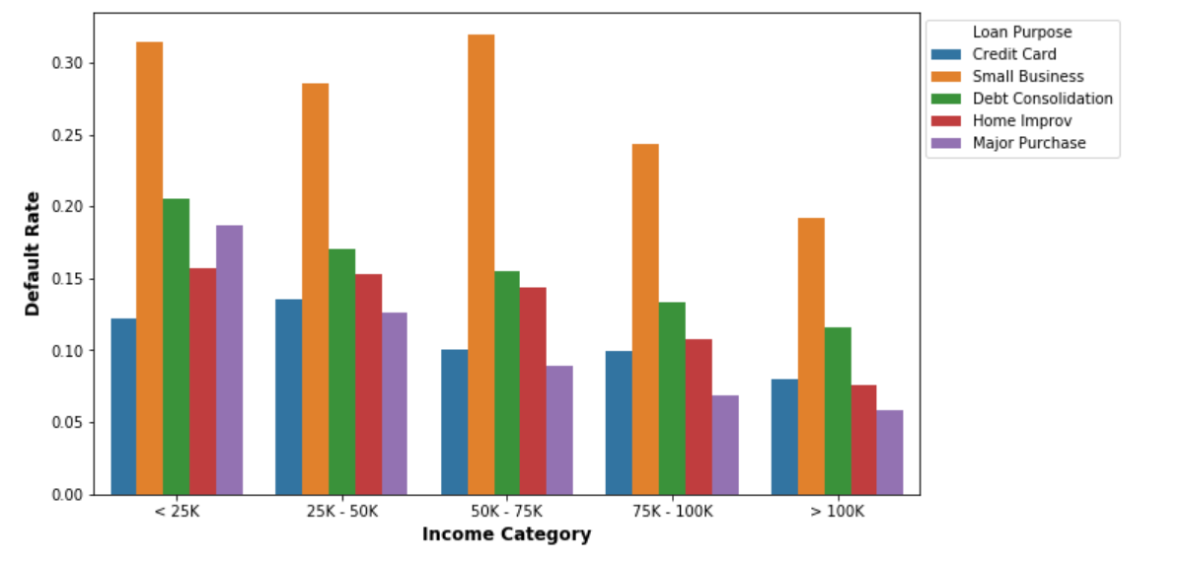
Analysis for Customer Demographic variables: Income Category
We can see that that Small Business has the highest default rate followed by Debt Consolidation in all income categories.
It can be seen that the trend is similar for all customer demographics. Debt Consolidation and Credit Card are the most popular loans. Small Business and Debt Consolidation have the highest default rate.

Slide 11
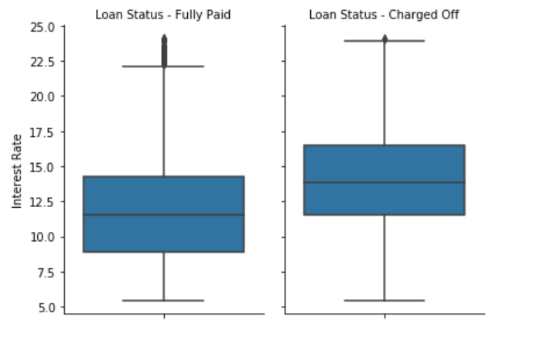
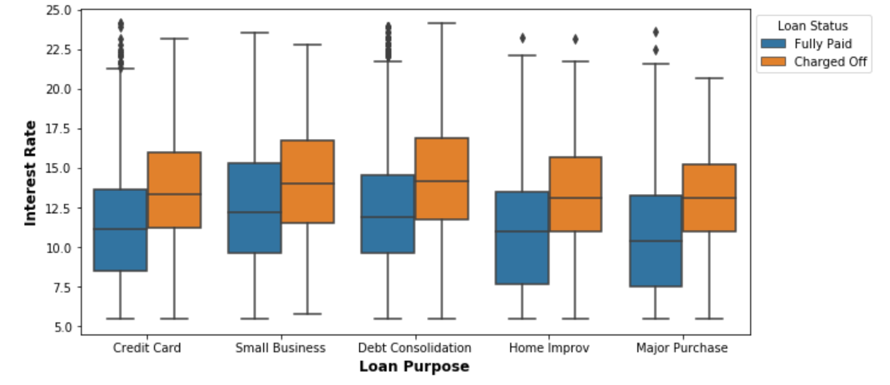
Analysis for Loan Characteristics: Interest Rate
It can be seen that loans which default tend who have higher interest rate than loans that don't.
We can see that above observation holds true across purposes, that loans that default tend to have higher interest rates than those that don't.

Slide 12
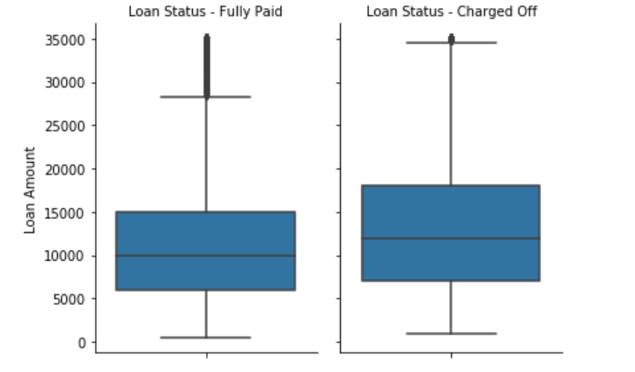
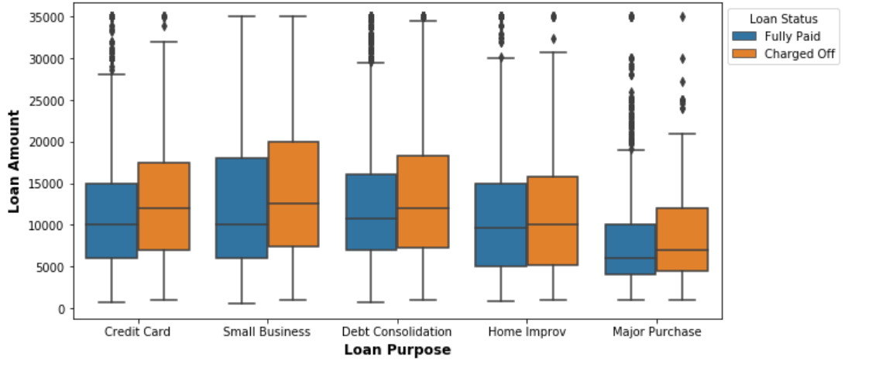
Analysis for Loan Characteristics: Loan Amount
We can see that as the loan amount goes up, the changes of default increases.
Here we can see that for the purposes which have a higher default rate (Small business, debt consolidation and credit card), the median borrowed amount is higher in case of the defaulted loans.

Slide 13
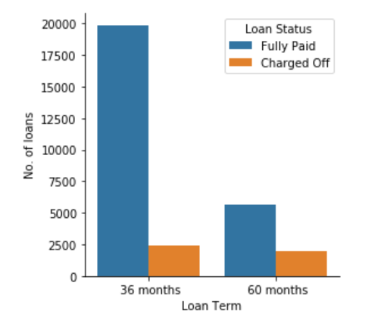
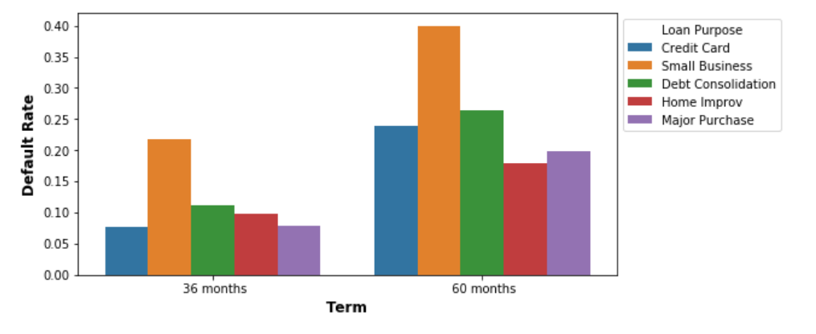
Analysis for Loan Characteristics: Loan Term
We can see that the number of defaulters is almost the same for both the term periods. However there's a noticeable difference when it comes to fully paid loans.
This indicates a higher likelihood of default on loans with the longer term period of 60 months.
The observation made is consistent across purposes, the default rate is high for loans with a higher term.

Slide 14
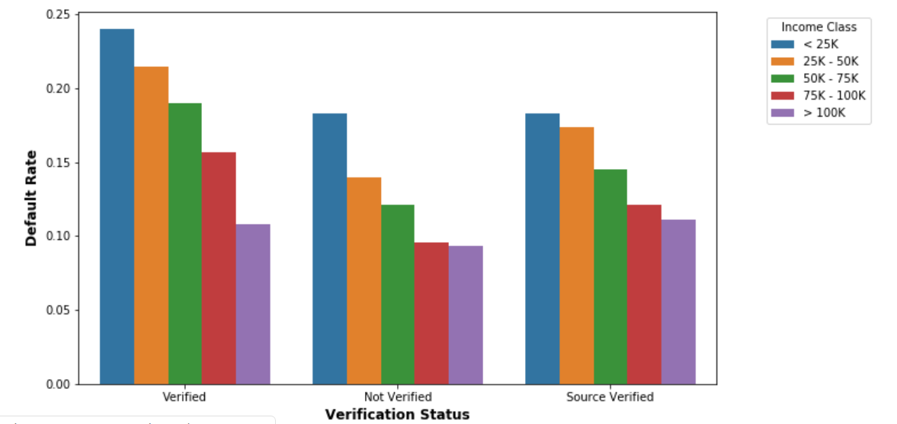
Analysis for Loan Characteristics: Verification Status across Income Categories
This is a striking observation that for all verification statuses, lower income groups have a higher default rate than higher income groups.
Also, borrowers who're not verified have a larger contribution to the business and maintain a lower default rate as compared to verified and source-verified customers.

Slide 15
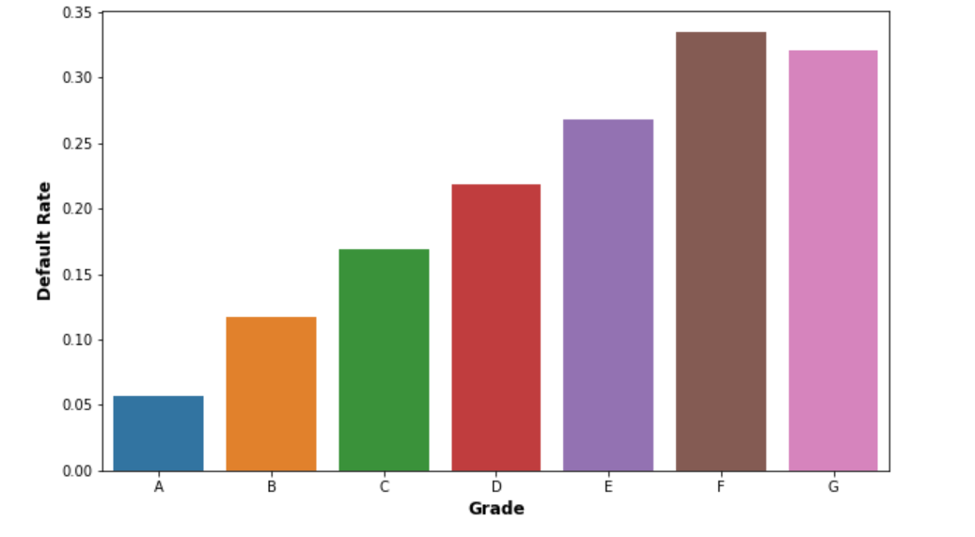
Analysis for Loan Characteristics: Grades
We can see here that the although the default rate for grade A is low (less than 5%), default rate for B(~12%), C(~17%) and D(~21%) is high.
A, B, C & D account for ~80% of the business.
A small improvement in grades A, B, C and D w.r.t. default rate can significantly decrease the credit loss.

Slide 16
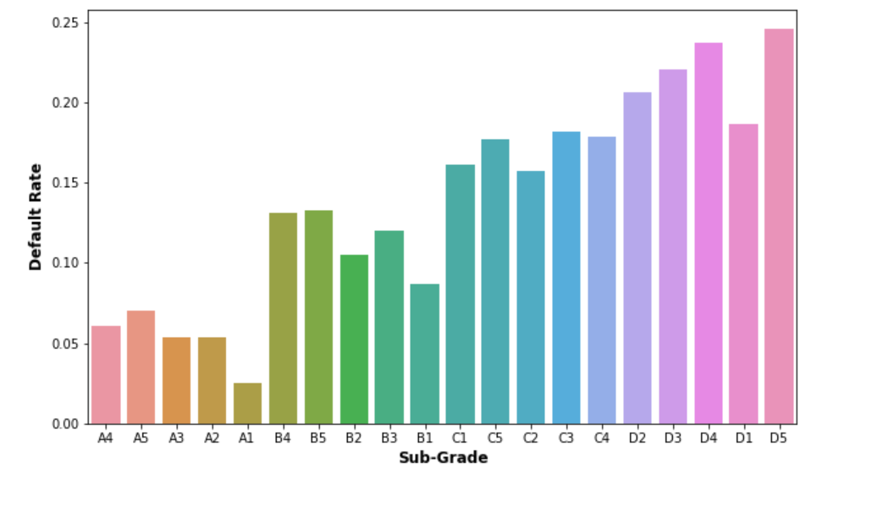
Analysis for Loan Characteristics: Sub-Grades
We can see here that the default rates for the sub-grades are in line with order of the default rate for the grades.

Slide 17
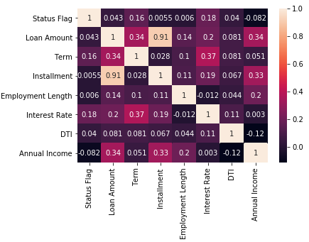
Correlation Study
The correlation heat-map tells the following about defaulters:
1. Longer term period most likely comes with a higher interest rate. It also suggests higher loan amount and installment. These factors show a higher likelihood of defaulting.
2. Income is negatively correlated, although the value is small. This is in-line with lower default rates observed in high income groups and vice versa.
3. Larger installment is not very strongly correlated with defaulting. However when coupled with high interest rate and loan amount it becomes significant.
4. It also shows that high income borrowers taking small low interest loans are less likely to default.

Slide 18
Inferences
Strong areas of focus to predict the risk of default
Purpose - Debt Consolidation and credit card loans account for more than 65% of the business and have high default rates.
Income Group - Low income groups have high default rate for Debt Consolidation and Home Improv loans. Small Business loans have high default rate across all income categories.
Interest Rate - Loans with high interest default more as compared to low interest rate across all identified loan purposes.
Loan Term - Loans with higher term tend to default more across all identified loan purposes.
Verification Status - One strange observation made is that Verified loans tend to default more than Not-Verified loans.
Grade - Grades A, B, C and D contribute the most to the revenue and have high default-rates.

